Slide 1

C Programming Constructs
by Karthik subramanian

Slide 2
C: Introduction to Programming Constructs
Programming constructs are the basic elements/components of a C program
They decide:
What the program does?
How does it flow? OR What is the sequence of steps?

Slide 3
Programming Constructs in C
Variables
Methods
Pointers and Arrays
Structs
Control structures (if /else if/else) ,(switch case)
For and while loops and do while
Input and output (to console or to a file)

Slide 4
C Variables
Minimal variable declaration requires data type and variable name.
<data-type> <variable>
Examples:
.int num;
char cVal;
char name[10];
float profit;

Slide 5
Variables - Strongly typed vs loosely typed
Strongly typed languages: A strongly typed programming language is always pending of their variable data type. This is because the system checks the object type before an operation requiring a certain type is called on such variable giving either a compilation error or runtime error.
C is an example of strongly typed language.

Slide 6
Variables
Loosely typed languages: a loosely typed programming language does not have such strong bounds on their variable data type. The compiler or interpreter may allow some errors to slip by when it checks if a wrong operation is being called on a variable regardless of its type.
Examples of loosely typed languages are Javascript, perl, PHP, Visual Basic etc.
The following code in Perl is an example of loosely typed variable:
var v1= 23;
console.log(v1);
/*and here, the data type of variable named v1 is changed*/
v1 ="changed";
console.log(v1);

Slide 7
Strongly typed vs loosely typed languages
Strongly typed language | Loosely typed language
It is necessary to specify the data type of a variable. | It's not necessary to specify the data type of a variable.
Programming flexibility is not permitted. | It gives programming flexibility.
takes up more memory | Takes up less memory
This prevents simple data type conversion. | This makes data type conversion simple.
It has no flexibility. | It has flexibility.
Eg. Java, c++, c, c#, python, etc | Eg. Javascript, typescript, php, etc

Slide 8

C Variables
C is not object oriented, therefore, access specifiers such as private/protected/public are not available, like in C++/Java.
Example, the following code will not compile:
struct Employee
{
private:
char empName[10];
int empno;
};

Slide 9
C Expressions
Expressions
Arithmetic
Relational
Logical
Conditional

Slide 10
C : Arithmetic expressions
C arithmetic operations play a vital role in performing mathematical calculations in C programming.
These operations allow you to manipulate numerical data and provide meaningful outputs. C arithmetic operations play a vital role in performing mathematical calculations in C programming.
These operations allow you to manipulate numerical data and provide meaningful outputs.

Slide 11
C: Arithmetic expressions
Consists of operands and arithmetic operators.
Performs computation on variables/constants which may be of int, float, double or char or even pointers
Can be performed on single or multiple lines of code
C programming supports various arithmetic operations to perform calculations on different types of data. These operations include basic operations (addition, subtraction, multiplication, and division) and advanced operations (modulus, increment, decrement, and pointer arithmetic).

Slide 12
C: Hierarchy of Arithmetic expressions
Hierarchy of Arithmetic Operations in C
C programming follows a hierarchy of arithmetic operations similar to the conventional order of mathematical operations. This means that some arithmetic operations take precedence over others. The hierarchy is as follows:
Parentheses ()
Multiplication, Division, and Modulus (*, /, and %)
Unary Prefix Operators (++ and --)
Addition and Subtraction (+ and -)
Assignment
Postfix Operator (++ and --)
The higher the position of an operation in this hierarchy, the greater precedence it has. Arithmetic operators of equal precedence are evaluated from left to right.

Slide 13
C: Pointer arithmetic
Pointer Arithmetic Operations in C
In C programming, pointers are variables that hold memory addresses of other variables. Pointer arithmetic operations are a unique feature allowing you to perform calculations directly on memory addresses.
Pointer arithmetic is the process of manipulating pointer values by using arithmetic operators. C programming supports four basic arithmetic operations on pointers: addition, subtraction, increment, and decrement.

Slide 14
C: Arithmetic operations
Rules and Examples of C Arithmetic Operators Precedence
The precedence rules for C arithmetic operators are as follows:
Operators within parentheses are evaluated first.
Unary operators (++ and --) have higher precedence than other arithmetic operators.
Multiplication, division, and modulus operators have higher precedence than addition and subtraction operators.
If operators have the same precedence, they are evaluated from left to right.

Slide 15
C Arithmetic expression
Evaluation of expression | Description of each operation
6*2/( 2+1 * 2/3 +6) +8 * (8/4) | An expression is given.
6*2/(2+2/3 + 6) + 8 * (8/4) | 2 is multiplied by 1, giving the value 2.
6*2/(2+0+6) + 8 * (8/4) | 2 is divided by 3, giving a value 0
6*2/ 8+ 8 * (8/4) | 2 is added to 6, giving a value 8.
6*2/8 + 8 * 2 | 8 is divided by 4, giving a value 2.
12/8 +8 * 2 | 6 is multiplied by 2, giving a value 12.
1 + 8 * 2 | 12 is divided by 8, giving a value 1.
1 + 16 | 8 is multiplied by 2, giving a value 16.
17 | 1 is added to 16, giving a value 17.

Slide 16
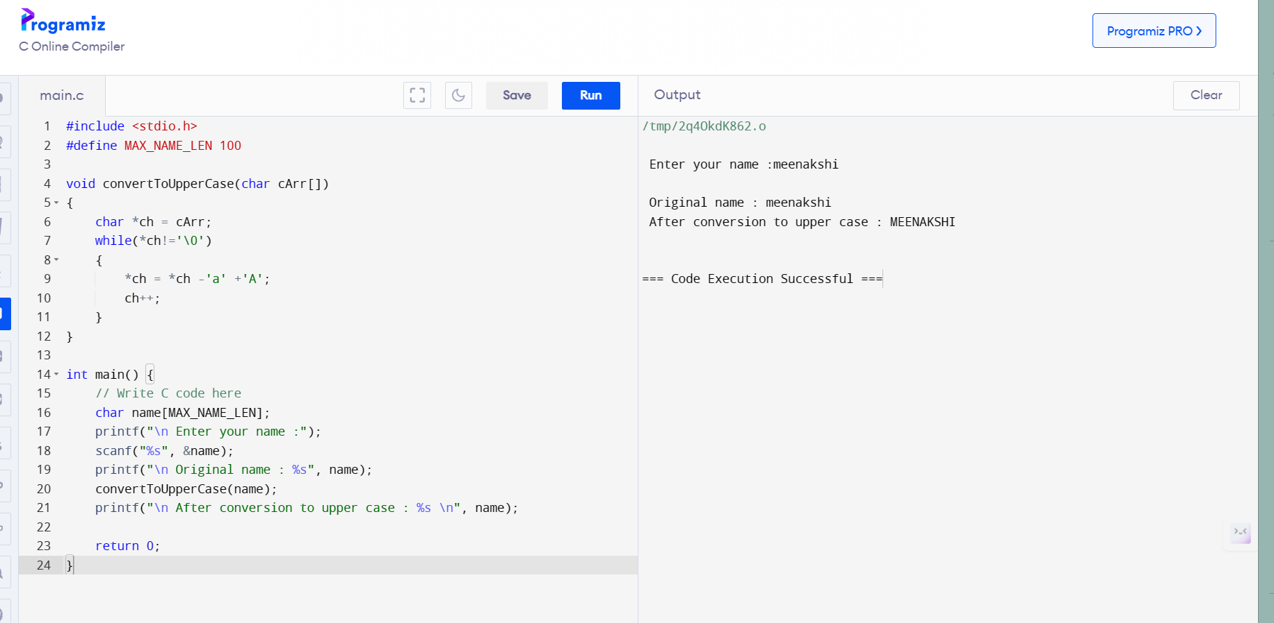
C: Arithmetic operators example

Slide 17
C Relational expressions
Relational Expression in C
Relational expressions use comparison operators such as '>' (greater than) and '<' (less than) to compare two operands. The result of the comparison is a boolean value i.e. 0(false) or non-zero (true).
It is a condition that decides whether the action should be taken or not. Relational expressions are used in decision-making statements and looping statements in the C language.

Slide 18
C Relational expressions
Relational Expression | Description
x%2 == 0 | The given condition checks whether the x is an even number or not. This relational expression shows the result as the value 1 if x is an even number otherwise as the value 0
a!=b | This relational expression is used to check if a is not equal to b and it results in 1 if a is not equal to b otherwise 0.
a+b = = x+y | It is used to check if this particular expression "a+b" is equal to the expression "x+y"
a>=9 | It is used to check if the value of a is greater than or equal to 9.

Slide 19
C Logical expression
Logical expressions in C are a powerful tool for controlling the logic of the flow of the program. They are made by combining as many relational expressions as the programmer wants. It then determines if certain statements or groups of statements should be executed or not.

Slide 20
C Logical expressions
Logical Expressions | Description
( x > 4 ) && ( x < 6 ) | This logical expression is used as a test condition to check if the x is greater than 4 and the x is less than 6. The result of the condition is true only when both conditions are true.
x > 10 || y <11 | This logical expression is used as a test condition to check if x is greater than 10 or y is less than 11. The result of the test condition is true if either of the conditions holds true value.
! ( x > 10 ) && ( y = = 2 ) | This logical expression is used as a test condition to check if x is not greater than 10 and y is equal to 2. The result of the condition is true if both the conditions are true

Slide 21
C conditional expression (ternary operator)
Returns the first expression if the condition is true else the second expression
var = (condition)?(result if true):(result if false);
Example:
void getPositiveOrNegative(int num)
{
(num>=0)?(printf(“\n Positive or 0”);):(printf(“\n Negative”););
}

Slide 22
C statements
C statements tell the compiler what needs to be done in the line.
They are terminated with a ;

Slide 23
Pseudocode
Pseudocode is a step by step description of an algorithm
It is the intermediate step between the conceptual idea of a program and the actual code written
It is written in plain English and not written in any programming language.
It serves to make the process of conceptualizing the step by step procedure of writing a code and the steps needed to achieve that,

Slide 24
Pseudocode for common algorithms
Pseudocode for checking if a number is prime or not:
Input number n
Iterate from i = 2 to n/2
Check if n is divisible by i
If yes,
print “n is not prime”
return
Else, increment i
print “n is prime”

Slide 25
Time complexity of algorithms (Big O notation)
The complexity of a pseudocode explains how the code is executed and the variation of the number of lines executed as a function of the input given.
For instance, in the previous prime number elicitation, the complexity of the pseudocode is from 2 to n/2.
Which is O(n/2) = O(n)
The lower the complexity, the more efficient the algorithm or pseudocode.
This is why, we use binary search - complexity is O(log(n)) than traditional linear search O(n)
Also, we use quicksort and mergesort with average complexity of O(nlog(n)) compared to traditional bubble sort which has complexity of O(n²)

Slide 26
Bubble sort algorithm
Bubble sort compares neighbouring elements and swaps them if their relative positions is wrong.
It iterates over two nested loops and therefore the complexity is O(n²).

Slide 27
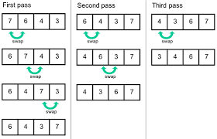
Bubble sort

Slide 28
Bubble sort algorithm
Bubble sort for integer array with size n (indexed from 0 to n-1) , ascending sort
Input integer array arr[] with size n
Iterate i from 0 to n-2
Iterate j from i+1 to n-1
If arr[i] > arr[j]
swap arr[i] and arr[j]
The complexity of the above algorithm is O(n-2)*O(n-1) which is O(n²)

Slide 29
Selection sort
Selection sort works by continuously selecting the smallest element for ascending sort (or largest element for descending sort) in an array and moving it to the beginning of the array
The complexity of selection sort is O(n²) similar to bubble sort as it has to use two nested loops.

Slide 30
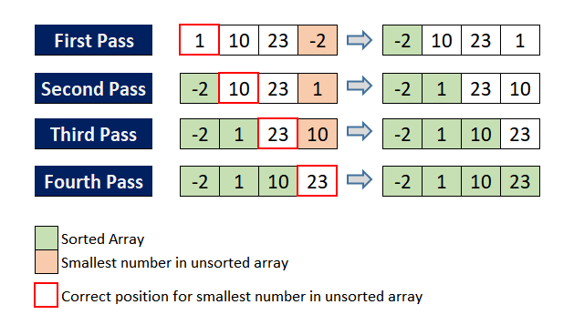
Selection sort

Slide 31
Pseudocode for selection sort
Input array of integers arr[] with size n
Iterate from i = 0 to n-2
smallIdx = i
Iterate from j = i+1 to n-1
If arr[smallIdx]>arr[j], smallIdx = j
Swap arr[i] with arr[smallIdx]

Slide 32
Insertion sort
Insertion sort is a simple sorting algorithm that works similarly to the way you sort playing cards in your hands. The array is virtually split into a sorted and an unsorted part. Values from the unsorted part are picked and placed in the correct position in the sorted part.
Insertion Sort Algorithm
To sort an array of size N in ascending order iterate over the array and compare the current element (key) to its predecessor, if the key element is smaller than its predecessor, compare it to the elements before. Move the greater elements one position up to make space for the swapped element.

Slide 33
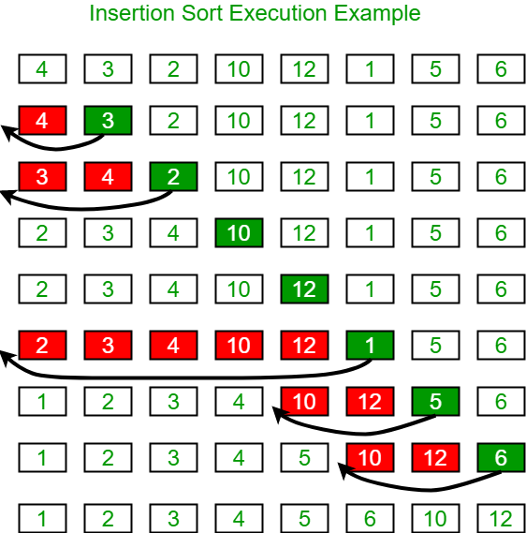
Insertion sort

Slide 34
Insertion sort - pseudocode for ascending sort
Input array of integers arr[] with size n indexed from 0 to n-1
Iterate i = 1 to n-1
key = arr[i]
Iterate j = i-1 to 0 if arr[j]> key
arr[j+1] = arr[j]
swap key with arr[j+1] = key

Slide 35
Insertion sort
The complexity of insertion sort is O(n²) as it involves two nested loops

Slide 36
Quicksort
Select a pivot element, say the first element
Place it in the right position
Since pivot element is in the correct position, sort the remaining 2 arrays arr(0..pivot-1) and arr(pivot+1) until the complete array is sorted

Slide 37
Pseudocode for Quicksort
Partition array
Input array arr[], low, high
Set pivot = arr[low]
Set i = low-1
Iterate from j = low to high
If arr[j]>pivot
i++
swap(arr[i], arr[j])
Return i+1

Slide 38
Pseudocode for QuickSort
Input array arr[], low, high
If low< high
pi = partition(arr, low, high)
quicksort(arr, low, pi-1)
quicksort(arr, pi+1, high)

Slide 39
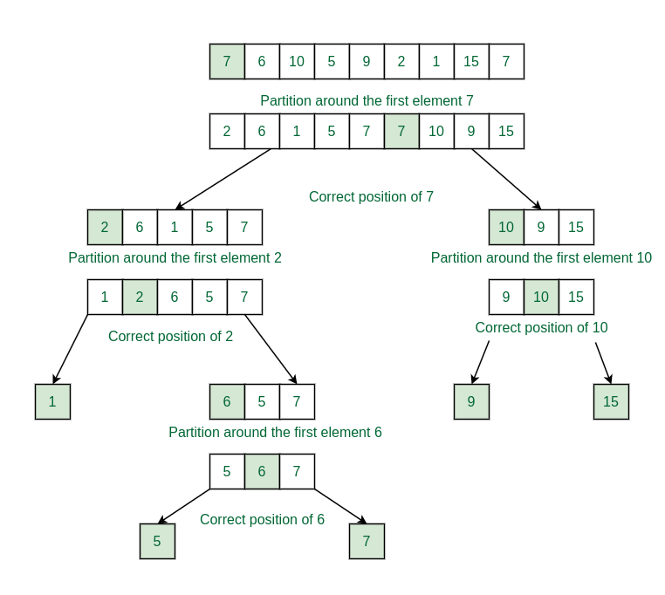
QuickSort

Slide 40
QuickSort
The average complexity is O(n(log(n))) with worst case being O(n²) and best case being O(log(n))
Therefore, a preferred choice.

Slide 41
Linear search
The most preferred search algorithm in an unsorted array
Compare the searched element with all the elements sequentially from 0 to n-1 until a match is found.
Complexity is O(n)

Slide 42
Linear search - pseudocode
Input array of integers arr[] with size n
Input number to be search val
Iterate i from 0 to n-1
If arr[i] = val, return position i
Return “element not found”

Slide 43
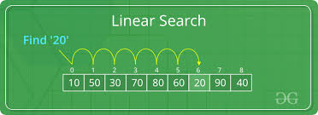
Linear Search

Slide 44
Linear Search
The best case is O(1)
The worst case is O(n)
The average complexity is O(n)

Slide 45
Binary search
Used in sorted arrays
Compare the element to be searched with the midpoint of the array
If element matches, return the index
Otherwise, use the new subarray to the left or to the right of the midpoint of the array.

Slide 46
Binary Search - Pseudocode
Input sorted integer arr[] with n elements indexed from 0 to n-1
Input number val
low = 0, high = n-1
mid = (low+mid)/2
If val = arr[mid] return mid
Else if val < arr[mid], high = mid-1
Else low = mid+1
Repeat steps 4 onwards

Slide 47
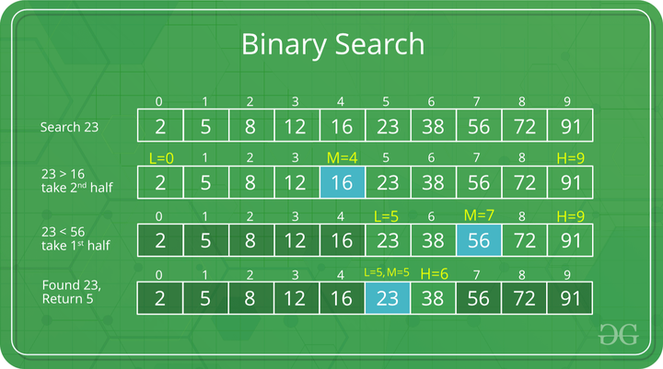
Binary Search

Slide 48
Binary Search
The average complexity is reduced, the best case being O(1) and the worst case being O(log(n))
The average complexity is O(log(n))

Slide 49
THE END

